Slide 1
Chapter 11
Database Performance Tuning and Query Optimization

Slide 2
Learning Objectives
After completing this chapter, you will be able to:
Identify the procedures involved in database performance tuning
Describe how a DBMS processes SQL queries in each of its three phases
Explain the role of indexes in speeding up data access
Differentiate between a rule-based optimizer and a cost-based optimizer
Describe some common practices used to write efficient SQL code
Explain how to formulate queries and tune the DBMS for optimal performance

Slide 3
Database Performance-Tuning Concepts (1 of 2)
One of the main functions of a database system is to provide timely answers
End users interact with the DBMS through the use of queries to generate information, using the following sequence:
1. End-user (client-end) application generates a query
2. Query is sent to the DBMS (server end)
3. DBMS (server end) executes the query
4. DBMS sends the resulting data set to the end-user (client-end) application
Goal of database performance is to execute queries as fast as possible
Database performance tuning: set of activities and procedures that reduce response time of database system
Fine-tuning the performance of a system requires a holistic approach
All factors must operate at optimum level with minimal bottlenecks

Slide 4
Database Performance-Tuning Concepts (2 of 2)
Table 11.1 General Guidelines for Better System Performance
 | System Resources | Client | Server
Hardware | CPU | The fastest possible Dual-core CPU or higher "Virtualized Client desktop technologies could also be used" | The fastest possible Multiple processors (quad-core technology or higher) Cluster of networked computers "Virtualized server technology could be used"
 | RAM | The maximum possible to avoid OS memory to disk swapping | The maximum possible to avoid OS memory to disk swapping
 | Storage | Fast SATA/EIDE hard disk with sufficient free hard disk space solid state drives (SSDs) for faster speed | Multiple high-speed, high-capacity disks Fast disk interface (SAS / SCSI / Firewire / Fibre Channel) RAID configuration optimized for throughput Solid state drives (SSDs) for faster speed Separate disks for OS, DBMS, and data spaces
 | Network | High-speed connection | High-speed connection
Software | Operating system (OS) | 64-bit OS for larger address spaces Fine-tuned for best client application performance | 64-bit OS for larger address spaces Fine-tuned for best server application performance
 | Network | Fine-tuned for best throughput | Fine-tuned for best throughput
 | Application | Optimize SQL in client application | Optimize DBMS server for best performance

Slide 5
Performance Tuning: Client and Server
Client side: SQL performance tuning
Generate SQL query that returns correct answer in least amount of time
Using minimum amount of resources at server
Server side: DBMS performance tuning
DBMS environment is configured to respond to clients’ requests as fast as possible
While making optimum use of existing resources

Slide 6
DBMS Architecture (1 of 3)
All data in a database are stored in data files
Data files automatically expand in predefined increments known as extends
Data files are grouped in file groups or table spaces
Logical grouping of several data files that store data with similar characteristics
Data cache or buffer cache: shared, reserved memory area
Stores most recently executed SQL statements or PL/SQL procedures

Slide 7
DBMS Architecture (2 of 3)
SQL cache or procedure cache: shared, reserved memory
Stores most recently executed SQL statements or PL/SQL procedures
DBMS retrieves data from permanent storage and places them in RAM
Data is retrieved from the data files and placed in the data cache
Input/output request: low-level data access operation that reads or writes data to and from computer devices
Data cache is faster than working with data files
Majority of performance-tuning activities focus on minimizing I/O operations

Slide 8
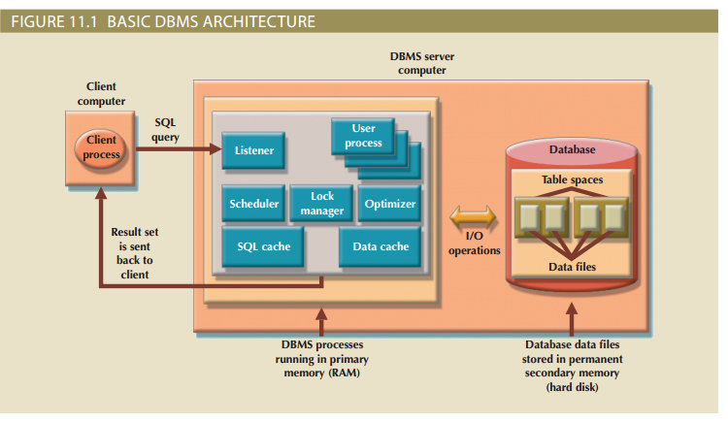
DBMS Architecture (3 of 3)

Slide 9
Database Query Optimization Modes (1 of 4)
Algorithms proposed for query optimization are based on selection of:
Optimum order to achieve the fastest execution time
Sites to be accessed to minimize communication costs
Evaluated based on:
Operation mode
Timing of its optimization

Slide 10
Database Query Optimization Modes (2 of 4)
Classification of operation modes
Automatic query optimization: DBMS finds the most cost-effective access path without user intervention
Manual query optimization: requires that optimization be selected and scheduled by the end-user or programmer

Slide 11
Database Query Optimization Modes (3 of 4)
Classification based on timing of optimization
Static query optimization: best optimization strategy is selected when the query is compiled by the DBMS
Takes place at compilation time
Dynamic query optimization: access strategy is dynamically determined by the DBMS at run time, using the most up-to-date information about the database
Takes place at execution time

Slide 12
Database Query Optimization Modes (4 of 4)
Classification based on type of information used to optimize the query
Statistically based query optimization algorithm: statistics are used by the DBMS to determine the best access strategy
Statistical information is generated by DBMS through:
Dynamic statistical generation mode
Manual statistical generation mode
Rule-based query optimization algorithm: based on a set of user-defined rules to determine the best query access strategy

Slide 13
Database Statistics (1 of 2)
Measurements about database objects; provide a snapshot of database characteristics
Number of processors used
Processor speed
Temporary space available

Slide 14
Database Statistics (2 of 2)
Table 11.2 Sample Database Statistics Measurements
Database Object | Sample Measurements
Tables | Number of rows, number of disk blocks used, row length, number of columns in each row, number of distinct values in each column, maximum value in each column, minimum value in each column, and columns that have indexes
Indexes | Number and name of columns in the index key, number of key values in the index, number of distinct key values in the index key, histogram of key values in an index, and number of disk pages used by the index
Environment Resources | Logical and physical disk block size, location and size of data files, and number of extends per data file

Slide 15
Query Processing (1 of 2)
Parsing
DBMS parses the SQL query and chooses the most efficient access/execution plan
Execution
DBMS executes the SQL query using the chosen execution plan
Fetching
DBMS fetches the data and sends the result set back to the client

Slide 16
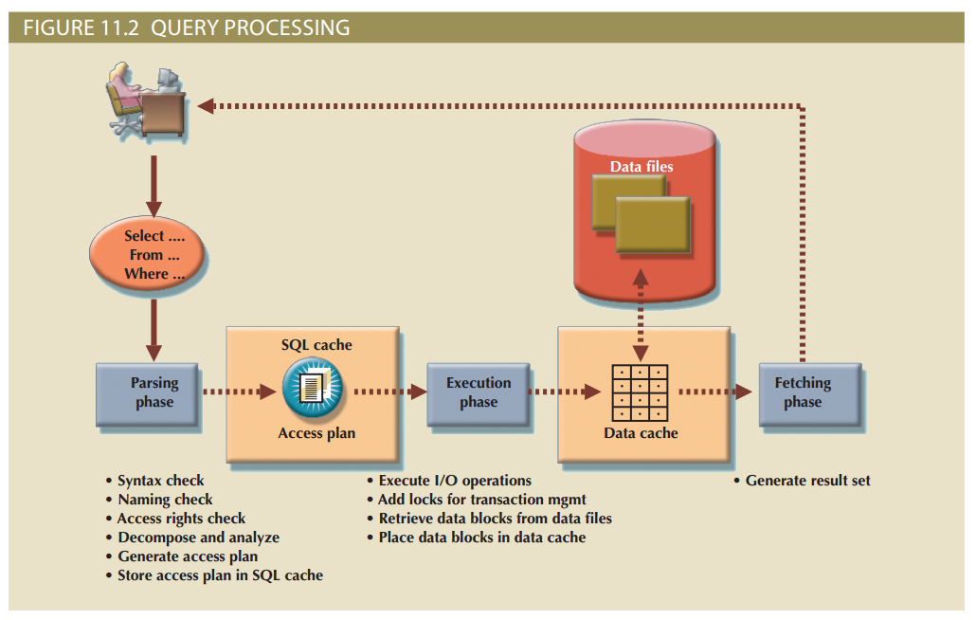
Query Processing (2 of 2)

Slide 17
SQL Parsing Phase (1 of 2)
Query is broken down into smaller units
Original SQL query transformed into slightly different version of original SQL code which is fully equivalent and more efficient
Query optimizer: analyzes SQL query
Finds most efficient way to access data
Access plans: result of parsing a SQL statement; contains a series of steps the DBMS will use to execute the query and return the result set in the most efficient way
Access plan exists for query in SQL cache: DBMS reuses it
No access plan: optimizer evaluates various plans and chooses one to be placed in SQL cache for use

Slide 18
SQL Parsing Phase (2 of 2)
Table 11.3 Sample DBMS Access Plan I/O Operations
Operation | Description
Table scan (full) | Reads the entire table sequentially, from the first row to the last, one row at a time (slowest)
Table access (row ID) | Reads a table row directly, using the row ID value (fastest)
Index scan (range) | Reads the index first to obtain the row IDs and then accesses the table rows directly (faster than a full table scan)
Index access (unique) | Used when a table has a unique index in a column
Nested loop | Reads and compares a set of values to another set of values, using a nested loop style (slow)
Merge | Merges two data sets (slow)
Sort | Sorts a data set (slow)

Slide 19
SQL Execution Phase
All I/O operations indicated in the access plan are executed
Locks are acquired
Data are retrieved and placed in data cache
Transaction management commands are processed

Slide 20
SQL Fetching Phase
Rows of resulting query result set are returned to client
DBMS may use temporary table space to store temporary data
Database server coordinates the movement of the result set rows from the server cache to the client cache

Slide 21
Query Processing Bottlenecks
Delay introduced in the processing of an I/O operation that slows the system
Caused by the:
CPU
RAM
Hard disk
Network
Application code

Slide 22
Indexes and Query Optimization (1 of 3)
Indexes
Help speed up data access
Facilitate searching, sorting, using aggregate functions, and join operations
Ordered set of values that contain the index key and pointers
More efficient than a full table scan; index data is preordered and the amount of data is usually much smaller

Slide 23
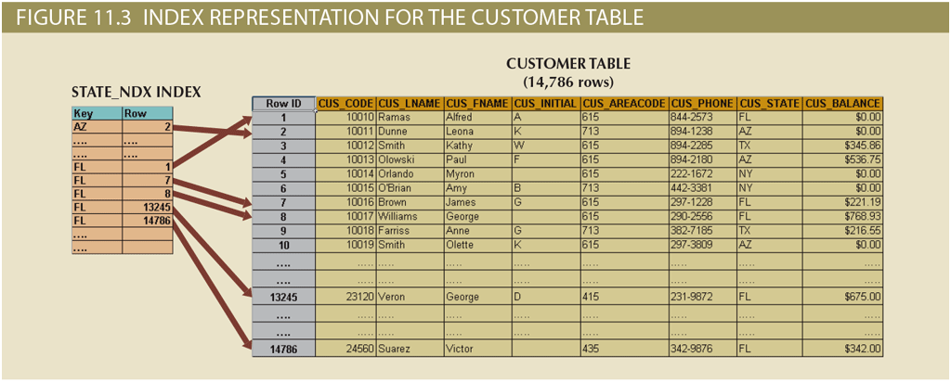
Indexes and Query Optimization (2 of 3)

Slide 24
Indexes and Query Optimization (3 of 3)
Data sparsity: number of different values a column could have
High or low
Data structures used to implement indexes
Hash indexes
B-tree indexes
Bitmap indexes
DBMS determines best type of index to use

Slide 25
Optimizer Choices
Rule-based optimizer: uses preset rules and points to determine the best approach to execute a query
Rules assign a “fixed cost” to each SQL operation
Cost-based optimizer: uses algorithms based on statistics about objects being accessed to determine the best approach to execute a query
Optimizer process adds up the processing cost, I/O costs, and resource costs (RAM and temporary space) to determine the total cost of a given execution plan

Slide 26
Using Hints to Affect Optimizer Choices (1 of 2)
Optimizer might not choose the best execution plan
Makes decisions based on existing statistics; might be old
Might choose less-efficient decisions
Optimizer hints: special instructions for the optimizer
Embedded in the SQL command text

Slide 27
Using Hints to Affect Optimizer Choices (2 of 2)
Table 11.5 Optimizer Hints
Hint | Usage
ALL_ROWS | Instructs the optimizer to minimize the overall execution time—that is, to minimize the time needed to return all rows in the query result set. This hint is generally used for batch mode processes. For example: SELECT /*+ ALL_ROWS */ * FROM PRODUCT WHERE P_QOH < 10;
FIRST_ROWS | Instructs the optimizer to minimize the time needed to process the first set of rows—that is, to minimize the time needed to return only the first set of rows in the query result set. This hint is generally used for interactive mode processes. For example: SELECT /*+ FIRST_ROWS */ * FROM PRODUCT WHERE P_QOH < 10;
INDEX(name) | Forces the optimizer to use the P_QOH_NDX index to process this query. For example: SELECT /*+ INDEX(P_QOH_NDX) */ * FROM PRODUCT WHERE P_QOH < 10

Slide 28
SQL Performance Tuning
Evaluated from client perspective
Most current relational DBMSs perform automatic query optimization at the server end
Most SQL performance optimization techniques are DBMS-specific and thus rarely portable
Majority of performance problems are related to poorly written SQL code
A carefully written query almost always outperforms a poorly written one

Slide 29
Index Selectivity
Measure of the likelihood that an index will be used in query processing
Indexes are used when a subset of rows from a large table is to be selected based on a given condition
Cannot always be used to improve performance
Function-based index: based on a specific SQL function or expression

Slide 30
Conditional Expressions (1 of 2)
Expressed within WHERE or HAVING clauses of a SQL statement
Restricts the output of a query to only rows matching conditional criteria
Guidelines to write efficient conditional expressions in SQL code
Use simple columns or literals as operands
Numeric field comparisons are faster than character, date, and NULL comparisons
Equality comparisons are faster than inequality comparisons
Transform conditional expressions to use literals
Write equality conditions first when using multiple conditional expressions
When using multiple AND conditions, write the condition most likely to be false first
When using multiple OR conditions, put the condition most likely to be true first
Avoid the use of NOT logical operator

Slide 31
Conditional Expressions (2 of 2)
Table 11.6 Conditional Criteria
Operand1 | Conditional Operator | Operand2
P_PRICE | > | 10.00
V_STATE | = | FL
V_CONTACT | LIKE | Smith%
P_QOH | > | P_MIN * 1.10

Slide 32
Query Formulation
Step to formulate a query
Pinpoint what columns and computations are required
Identify source tables
Decide how to join tables
Establish action criteria are needed
Determine the order in which to display the output

Slide 33
DBMS Performance Tuning (1 of 2)
Managing DBMS processes in primary memory and the structures in physical storage
DBMS performance tuning at server end focuses on setting parameters used for:
Data cache
SQL cache
Sort cache
Optimizer mode
In-memory database: store large portions of the database in primary storage
These systems are becoming popular
Increasing performance demands of modern database applications
Diminishing costs
Technology advances of components

Slide 34
DBMS Performance Tuning (2 of 2)
Recommendations for physical storage of databases
Utilize I/O accelerators
Use RAID (Redundant Array of Independent Disks) to provide a balance between performance improvement and fault tolerance
Minimize disk contention
Put high-usage tables in their own table spaces
Assign separate data files in separate storage volumes for indexes, system, and high-usage tables
Take advantage of the various table storage organizations in the database
Partition tables based on usage
Apply denormalized tables where appropriate
Store computed and aggregate attributes in tables

Slide 35
Summary (1 of 2)
Database performance tuning refers to a set of activities and procedures designed to ensure that an end-user query is processed by the DBMS in the least amount of time
Database statistics refer to a number of measurements gathered by the DBMS that describe a snapshot of the database objects’ characteristics
DBMSs process queries in three phases: parsing, execution, and fetching
Indexes are crucial in the process that speeds up data access
During query optimization, the DBMS must choose what indexes to use, how to perform join operations, which table to use first, and so on
A rule-based optimizer uses preset rules and points to determine the best approach to execute a query

Slide 36
Summary (2 of 2)
SQL performance tuning deals with writing queries that make good use of the statistics
Query formulation deals with how to translate business questions into specific SQL code to generate the required results
DBMS performance tuning includes tasks such as managing the DBMS processes in primary memory (allocating memory for caching purposes) and managing the structures in physical storage (allocating space for the data files)

